Slide 1
Ch.2 Modeling the process and life cycle

Slide 2
1. The meaning of process
Process
  A set of ordered tasks
  A series of steps involving activities, constraints, and resources that produce an intended output of some kind
  A process usually involves a set of tools and techniques

Slide 3
Life cycle and Software life cycle
Life cycle
  The process to build some of product.
Software life cycle（软件生命周期）
  The software development process.
  It describes the life of a software product from its conception(概念) to its implementation（实现）, delivery（交付）, use（使用） and maintenance（维护）.

Slide 4
software development process
Requirements analysis and definition
System design
Program design
Writing programs (program implementation)
Unit testing
Integration testing
System testing
System delivery
Maintenance

Slide 5
2. Software process models
There are many process model in software engineering literature.
Reasons for modeling a process
  When a group writes down a description of its development process, it forms a common understanding of the activities, resources, and constraints involved in software development.
  Creating a process model helps the development team find inconsistencies(不一致), redundancies（冗余）, and omissions（忽略） in the process.
  The model should reflect the goal of development， such as building high-quality software，
  Every process should be tailored for the special situation in which it will be used.
Every software development process model includes system requirements as input and a delivered product as output.

Slide 6
Waterfall model
Figure 2.1, P49
The stages of software development are depicted as cascading(像瀑布一样的不可逆转的连续阶段) from one to another, one development stage should be complete before the next begins.
The waterfall model presents a very high-level view of what goes on during development, and it suggests to developers the sequence of events they should expect to encounter.
The waterfall model can be very useful in helping developers lay out what they need to do. its simplicity makes it easy to explain to customers who are not familiar with software development. It makes explicit which intermediate products are necessary in order to begin the next stage of development. Many other, more complex models are really just embellishment(添枝加叶，修饰，装饰) of the waterfall， incorporating feedback loops and extra activities(加入反馈环和额外的活动).

Slide 7
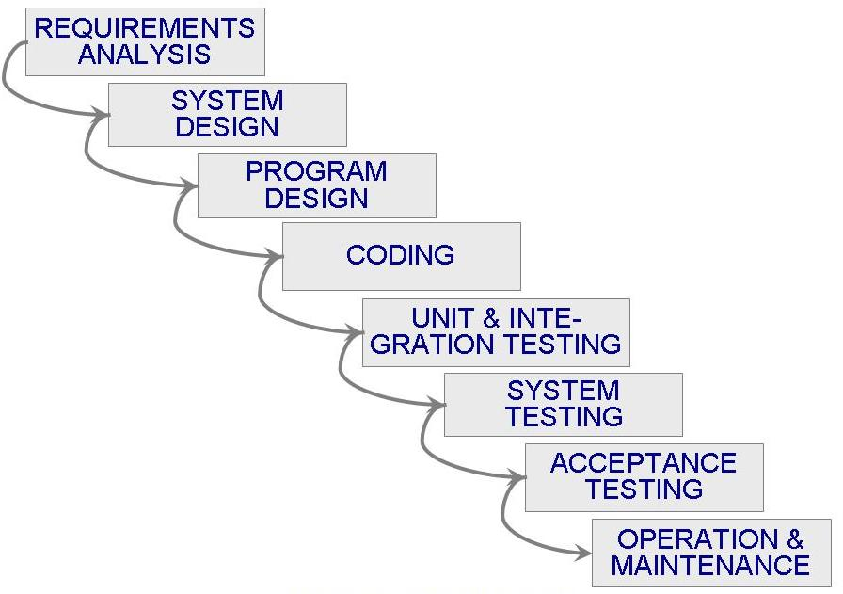
Waterfall Model
Figure 2.1 the waterfall model

Slide 8
Problems with the waterfall model
It dose not reflect the way code is really developed, software is usually developed with a great deal of iteration. P51, figure 2.2.
It needs a stable requirement.
It dose not reflect the great deal of iteration, figure 2.2, P51
It is failure to treat software as a problem-solving process.
It is so rudimentary（基本）as to be vacuous.（空洞）
It ignores the typical back-and forth activities that lead to creating a final product.

Slide 9
Prototype, validation, verification
Prototype (原型)
  is partially developed product that enables customers and developers to examine some aspect of proposed system and decide if it is suitable or appropriate for the finished product.
  Can be used to enhance waterfall model. figure 2.3,P52
  Prototyping is useful for verification and validation
Validation (确认)
  Ensures that the system has implemented all of the requirements
  Make sure building right product
Verification (验证)
  Ensures that each function works correctly
  Make sure the quality of product

Slide 10
V model
The V model is a variation of the waterfall model that demonstrates how the testing activities are related to analysis and design, figure 2.4,P53
The V model makes more explicit some of iteration and rework that are hidden in the waterfall depiction.
The V model focus on activity and correcctness.

Slide 11
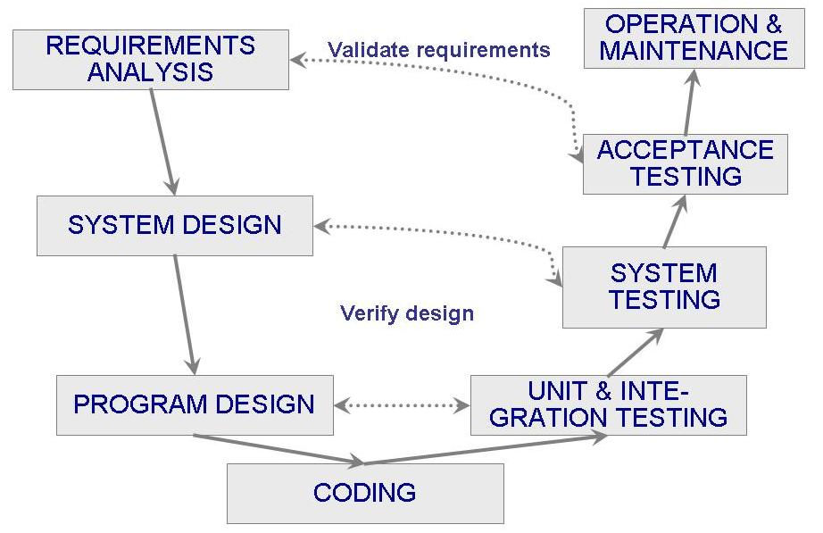
Figure 2.4 the V model

Slide 12
Prototype model
Show in figure 2.5, P53
The prototyping model allows all or part of a system to be constructed quickly to understand or clarify issues, it has the same objective as an engineering prototype, where the requirements or design require repeated investigation to ensure that the developer, user, customer have a common understanding both of what is needed and what is proposed.
The goal of Prototype model is reducing risk and uncertainty in development

Slide 13
The phased development model: increments and interactions
Cycle time
  The period between the time the requirements documents were written and the time the system was delivered.
One way to reduce cycle time is to use phase development, figure 2.8,P56
The system is designed so that it can be delivered in pieces, enabling the users to have some functionality while the rest is being developed. thus, there are two systems functioning in parallel, one is called production system which currently being used by user, another is called development system which is the next version that will replace the current production system.

Slide 14
Incremental development and iterative development
Incremental development
  The system is partitioned into subsystems by functionality. Release at begin is one small, functional subsystem and then adding functionality with the next release, the top of figure 2.9,P57
iterative development
  Interactive development delivers a full system at the very beginning and then changes the functionality of each subsystem with each new release. the bottom of figure 2.9,P57

Slide 15
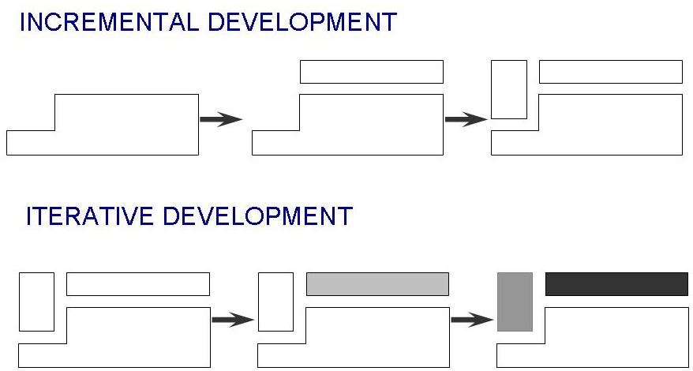
figure 2.9 the Incremental and Iterative models

Slide 16
The benefits of phased development
Training can begin on an early release, even some functions are missing.
Markets can be created early for functionality that has never before been offered.(还没有功能就可以开拓市场)
Frequent releases allow developers to fix unanticipated problems globally and quickly, as they are reported from the operational system.（频繁地发布允许开发者全面快速地修改原先未预料到的问题）.
The development team can focus on different areas of expertise with different release.(不同发布专注于不同的专业领域，这次搞定数据库，下次搞定报表)

Slide 17
Spiral model
A Spiral model could combine development activities with risk management to minimize and control risk.
The spiral model is beginning with the requirements and an initial plan for development, the process insert a step to evaluate risks and prototype alternatives before a “concept of operation” document is produced to describe at a high level how the system should work. The concept of operation is the product of the first iteration, and the requirements are the principal product of the second. In the third iteration, system development produce the design, and the fourth enables testing. Figure 2.10,P58.
With each iteration, the risk analysis weighs different alternatives(选择) in light of the requirements and constraints, and prototyping verifies feasibility（灵活性） or desirability（期望性） before a particular alternative is chosen.

Slide 18
Agile methods(敏捷方法)
Four tenets（原则） of agile Manifesto（敏捷宣言）
  They value individuals and interactions over processes and tools
  They prefer to invest time in producing working software rather than in producing comprehensive documentation
  They focus on customer collaboration rather than contract negotiation
  Then concentrate on responding to change rather than on creating a plan and then following it
The overall goal of agile development is to satisfy the customer by ” early and continuous delivery of valuable software ”

Slide 19
Agile processes
Agile processes
  Extreme programming (XP)极限编程
  Crystal 水晶
  Scrum 英式橄榄球的并列争球
  Adaptive software development (ASD)自适应软件开发
The phrase” Extreme programming (XP) is used to describe the more general concept of agile methods. The XP emphasize four characteristics of agility: communication、simplicity、courage、feedback.

Slide 20
Twelve facets of XP
The planning game 像做游戏讲故事一样规划
Small releases 小的发布
Metaphor 隐喻获得共识，不好直接表达，就用比喻隐喻获得共识，第一章建房过程隐喻开发过程
Simple design 使设计简单
Writing test first 尽早写测试
Refactoring 重构
Pair programming 结对编程
Collective ownership 集体所有
Continuous integration 持续的功能集成，不断小点小点的增加功能
Sustainable pace 可以接受的工作节奏
On-site customer 在场的客户
Coding standards 编码标准

Slide 21
Collections of process models
There are lots of process models, and they can be tailored to the needs of the user, customer, and developer. We really should capture the development process as a collection of process model, rather than focusing on a single model or view.
No matter what process model is used, many activities are common to all.

